Slide 2
objectives
Use digital color histograms to segment regions of interest in an image.

Slide 3
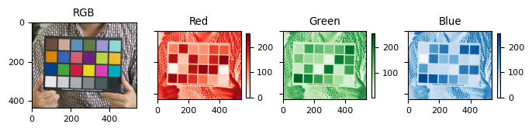
Background
Human eyes have cones and rods which allows depiction of trichromatic color and brightness, respectively. The same mechanism governs how digital cameras capture color and how devices display them. A colorful image shown below is a combination of three primary channels, namely Red, Green, and Blue.

Slide 4
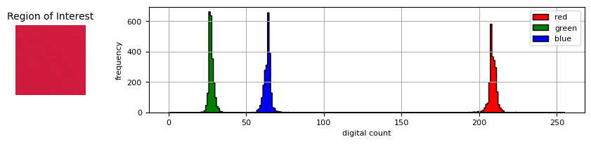
Thresholding

Slide 5
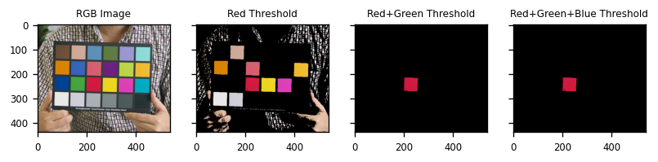
Thresholding

Slide 6
Non-parametric Segmentation

Slide 7
Non-parametric Segmentation
Next, we employ a parametric method in which properties from the region of interest (ROI) were used. Here I transformed first the RGB values into (NCC) to represent the image in terms of r and g values, and the mean and standard deviation of r and g shall be used to compute for the joint probabilistic map assuming a gaussian probability distribution [1]. Non-parametric method uses the histogram back-projection technique which was tackled in the previous activities [1]. The said method is non-computational since it treats histograms as just look-up tables [1].

Slide 8
Parametric

Slide 9
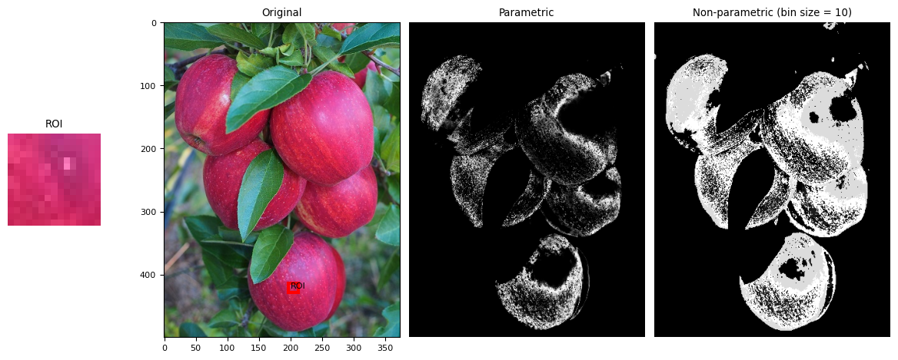
Non-Parametric

Slide 10
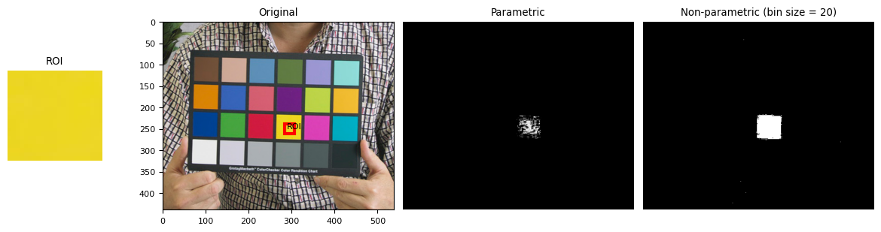

Slide 11
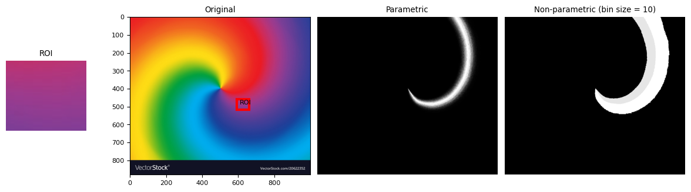
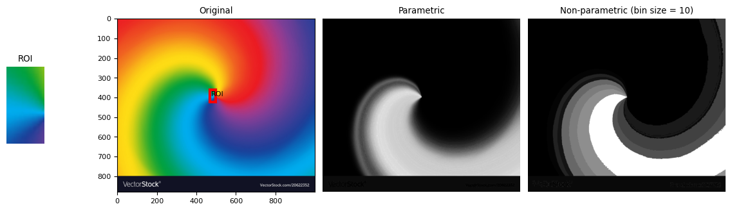

Slide 12
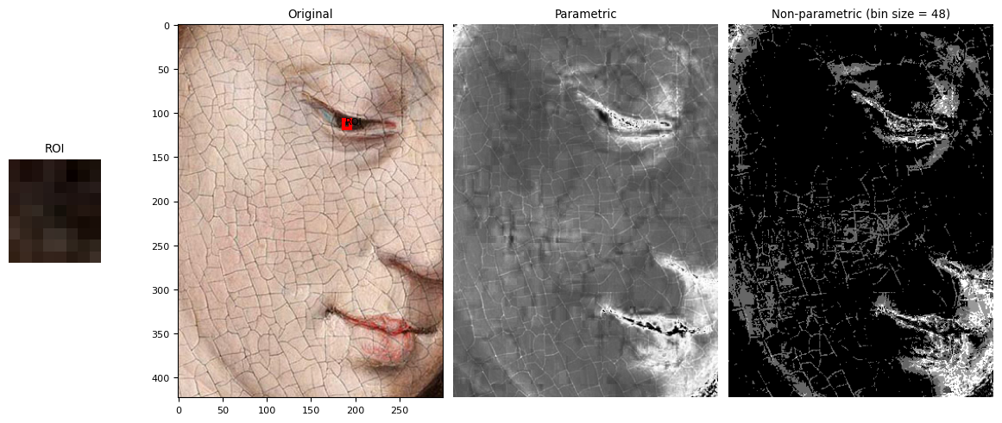
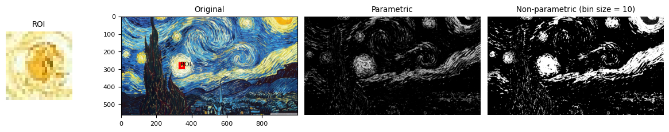
Art Applications

Slide 13
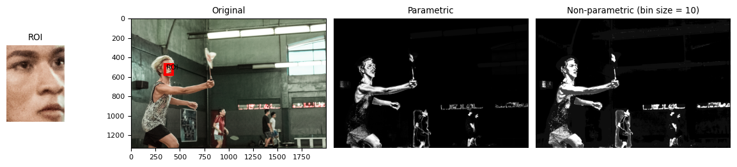
In motion

